Slide 1

PhD Candidature Confirmation
The Effects of Group Member’s Parameters on Human Crowd Modelling
Viet Vo
Supervisors: Bernd Meyer, Aldeida Aleti

Slide 2
Outline
Introduction
Research Questions
Contribution
Literature Review
Research Methodology
Current work & Timeline
Coursework
Notes:
Crowd modelling, and its importance, definition of group cohesion study and its importance

Slide 3
Introduction. Human Crowd Modelling
Human crowd model’s importance
Assess architectural design layout
Assess evacuation strategies
Offer key information for real-time crowd monitoring
Make crowd model more realistic
Calibration work
Study on behaviors which occur in both normal and emergency situations (cohesion, competition)
Notes:
Urban engineer and architecture often use human crowd model to simulate bbehavior of human to assess …
-crowd modelling is measured in festival by mobile data based on models, crowd density, or literal sides, pressure side to detect bottleneck where people could not escape on a narrow door
+=festival in Zurich
+= in Germany
-Crowd Modelling is the process of understanding human behaviour and build model
Calibration work to illustrate find realistic parameters from video recording or from documents
-such as group cohesion or

Slide 4
Introduction. Group Cohesion Behavior
Maintain group center of mass
Group of 2-4 members in normal situations
Members evacuate with group
Affect out-group pedestrian’s route choice and space occupation
Current models focus on the relation between group information and group population size
Notes:
-Reynold biologist, 1950s- through observation flying objects, flocking of pigions, maintain group center of mass.
-In biology of pegion, school of fish, flocking organism,
-Often observed 30-40% in normal situation: 37% at train station, 50% shopping centre, 28% university
Group members could be same in family, colleagues.
- Follow group by demography traits to maintain cohesion, family never escape alone, rather than evacuate alone. Also pedestrians select people to follow by demographic traits
Route choice- stimulus
Group- stick together, is also affect occupied space, empty. It is considered as moving obstacles.
Several models have been proposed to represents and explore group members maintain cohesion.
These model’s author come from physicts, necglect the importance of groups

Slide 5
Research Question
QUESTIONS:
Q1. What is the impact of group member’s parameters on group cohesion behaviour?
Q2. How does group cohesion behaviour affect flow rates?
IN SITUATIONS :
Members have same parameter values
Members have different parameter distributions
Notes:
This PhD research aims to explore the effect of members parameters on group cohesiveness through force model and the impact of group cohesiveness on flow rate measurement in scenarios when we varies these parameters.
First questions to understand how group behaviors according to input parameters and which is the most influential parameters which control group cohesion behavior
Flow rate is important standard to assess evacuation strategies and optimal layout.
Group members have different parameters because a current study found that different group members have different parameters
while current study considers group have same parameter parameter as homogeneous particles. These model’s comes from physics and mathematicians
To understand next step we need to know first when ped have scalar parameter values.

Slide 6
Contribution
Parameters contribute the most to the variance of group cohesion behaviour
Impact of group cohesion on flow rate in evacuation scenarios
Enhance real-time data extraction system and calibration works
Enhance space occupation prediction system
Notes:
This study enable modellers understand, modellers set values arbitrarily but the roles is important for measurement in simulation environment, assess simulation scenarios at which values.
Impact of group cohesion on flow rate to understand whether move individual or by group in evacuation plan
Refining and concentrating on the most influential parameters for real-time extraction system to enhance study, calibration work
And from known parameters values, possible varys, and prediction, evacuation simulation
When parameters vary, prediction system of occupied space and empty space for evacuation plan and crowd’s possible behaviour from known parameter distribution before deteriorative situations can occur.

Slide 7
Literature Review
Cellular automata-based model
Force-based model
Vicsek model
Notes:
Reason to choose these three models is because they are sufficiently to measure observable group behaviour in nature, in nature:
First two models are for human: lane formation, bottleneck, turbulence, fast-slower effect, crossing.
Last model is Vicsek, who co-author inveted force-model, the model for flocking of organism (pigeon, schooling fish); it is selected because it contain study of parameter values

Slide 8
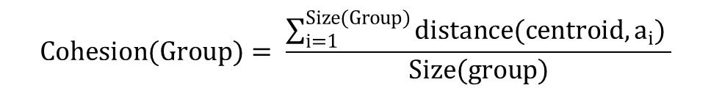

Literature Review. CA-based model
$Env=c_{0}, c_{1}, c_{2},c_{3},…$ where $∀c_{i}: c_{i} ∈Cell$
$$Pedestrian:(Id, GroupId, State, Actions, Destination)$$
$$Cohesion(Group)= \frac{\sum_{i=1}^{Size(Group)}{distance(centroid,a_{i})} }{Size(group)}$$
(Bandini & Vizzari, 2011)
Finding the cell to move in is based on group cohesion degree
and pedestrian information
Notes:
CA-based approach relies on the idea of Von Nonument , that divides space into uniform grid or hexagonal cells. Pedestrians is placed on cells. And a cell may contain more than one pedestrians.
At each time t, these variables are updated by the local rules of that cell or neighor cells; common rules are for moving direction or avoidance rules.
In simulation environments, pedestrian is presented as agents having attributes (groupId, action, state, target cell same with group, actions),
Cohesion value if pedestrians move into that cell.
Limitations of cell shapes and pedestrians only move one cell at a time interval

Slide 9







Literature Review. Force-based model
wall
$$\vec{γ}$$
$$γ_{1}$$
$$γ_{2}$$
target
$$\vec{e_{p}^{d}}(t)$$
$${\vec{f}}_{pq}$$
p
$${\vec{f}}_{group}$$
Group center of mass
$${\vec{f}}_{pγ}$$
q
(Helbing & Farkas & Vicsek, 1995, 2000)
(Moussaid & Helbing, 2010)
Notes:
Firstly by physicist and mathematics
And moussaid student, and helbing to create

Slide 10
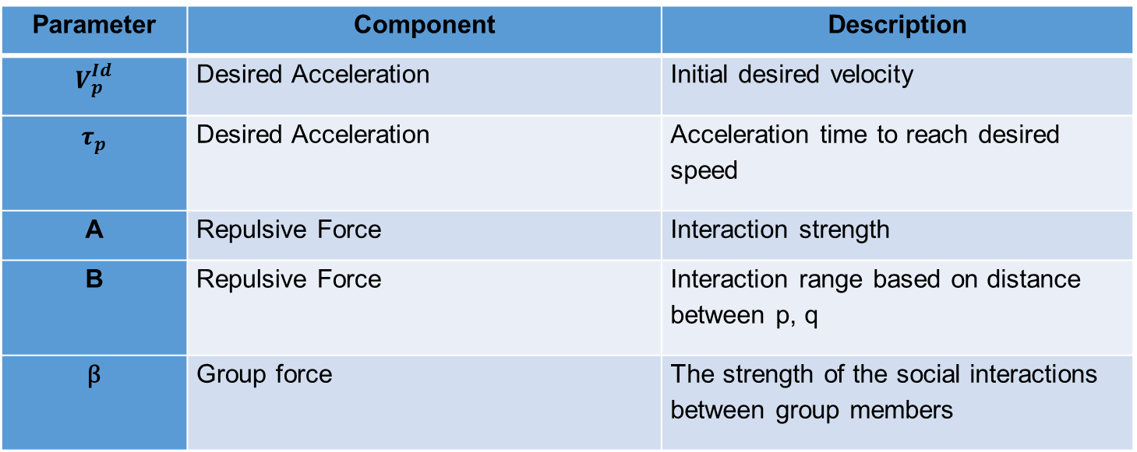
Literature Review. Force-based model
Parameter | Component | Description
$$V_{p}^{Id}$$ | Desired Acceleration | Initial desired velocity
$$τ_{p}$$ | Desired Acceleration | Acceleration time to reach desired speed
A | Repulsive Force | Interaction strength
B | Repulsive Force | Interaction range based on distance between p, q
β | Group force | The strength of the social interactions between group members
Notes:
Components, and other parameters about environment not mentioned here

Slide 11
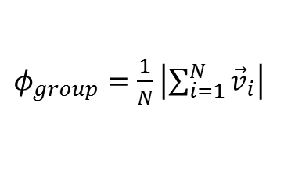
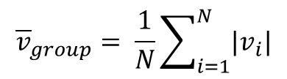
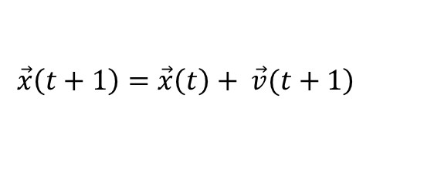
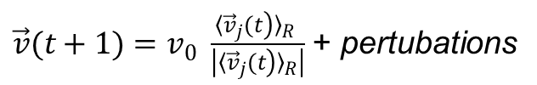
Literature Review. Vicsek model
$\vec{v}(t+1)=v_{0} \frac{{〈\left.{\vec{v}}_{j}(t\right)〉}_{R} }{\left|{〈\left.{\vec{v}}_{j}(t\right)〉}_{R}\right|}$ + pertubations
$$\left.\vec{x}\left(t+1\right)=\vec{x}\left(t\right)+ \vec{v}(t+1\right)$$
$${\overline{v}}_{group}= \frac{1}{N}\sum_{i=1}^{N}{|v_{i}|}$$
$φ_{group}=\frac{1}{N}\left|\sum_{i=1}^{N}{{\vec{v}}_{i}}\right|$
(Vicsek, Czirok, 1995)
Notes:
Vary by two components Radius, and pertubations

Slide 12
Literature Review. Critical Analysis
Group size increases
Group cohesion degree is proportional
Group’s average speed is inversely proportional
Group’s average velocity direction vanishes with decreasing of density
Previous models considers group members as homogeneous particles
Calibration work (Hooregoon, 2012) shows different parameters distributions for different pedestrians in age
The impact of group members parameters is unknown
The influence of group cohesion on flow rate is unknown
Notes:
Average direction is low when density low, pedestrians follows their own velocity direction rather than being affected by neighbors.
To understand group cohesion behaviour, previous authors considers as homogeneous
Consider as homogeneous, they neglect, use the same parameter for group members
The impact of group members parameters

Slide 13

Research Methodology. Q1
Impact of group member’s parameters when consider group contains members have the same parameter values
Group member’s initial parameters
Desired acceleration $V^{Id}$
Acceleration time $τ$
Interaction Strength $A$
Interaction Range B
Social group force simulation
Group cohesion measurement
Cohesion degree
Average speed
Average direction
Group member
Velocity
Moving direction
Notes:
CA-based approach relies on the idea of Von Nonument ,
Reason to choose these four parameters is because a recent calibration works show different in human
Social group force is selected because sufficient for human
Measure on group, and then how group affect back on individual
Describe the range of possible model’s outputs of the three factors given by a set of inputs at the four model’s parameters where the parameters have uncertainty.
Identify the key input parameters that contribute the most to the model’s outputs.

Slide 14
Research Methodology. Q1
1.Define distributions D₁, D_{2,} D_{3, …,} D_{k} for parameters
2.Generate samples x₁, x_{2,} x_{3, …,} x_{N} from the defined distributions
3.Run the model for samples to obtain model’s outputs
4.Explore the mapping between inputs and the output uncertainty
Principal Component Analysis
Variance-based Analysis (eFAST, ANOVA)
Morris scanning design
Sobol method
5.Trade-off individuality and group mates
Compare between moving with group and moving individually
Measure effects of other members on considering member by mixed-effect model
Notes:
Cover possible parameters
Run by cluster with large
Explore mapping
These method have been applied widely in biology research study
PCA is the first effort to understand the contribution of model’s output. By reduce dimensional of parameters to understand which parameters have highest correlation with first components, and mapping which model’s parameters contribute to the variance of model’s outputs.
Non-linear analysis. It partitions model’s outputs and identifiy the amount of outputs’s variation according to the uncertainty in the input parameters
ANOVA hypothesis testing measure different interaction of each pair of parameters and which parameters have contribute hight variance to the output data
Morris scanning is used to rank the most influential parameters. At a given parameter, run around to identify the model output. Repeats on other different nominal points.
Sobol method is based on decomposition of the model’s output into terms of increasing dimensionality and then compute the Sobol indices contribution of each parameter to the variance of model output.
Individual-conformation test
Linear mixed-effect models

Slide 15
Research Methodology. Q2
Group cohesion behaviour affect flow rates
Scenarios:
Move with group comparing to move individually to avoid obstacles
Group members interact with out-group individuals in corridor and evacuation simulations
Analysis:
Flow rate caused by (low-parameter, route choice, bottleneck)
Trajectory and forces affecting pedestrians
Notes:
-First scenarios is to understand whether move with group help pedestrians effective avoid obstacles
-Move with other group to in coordior and evacuation simulation environments, to test whether they affect on

Slide 16
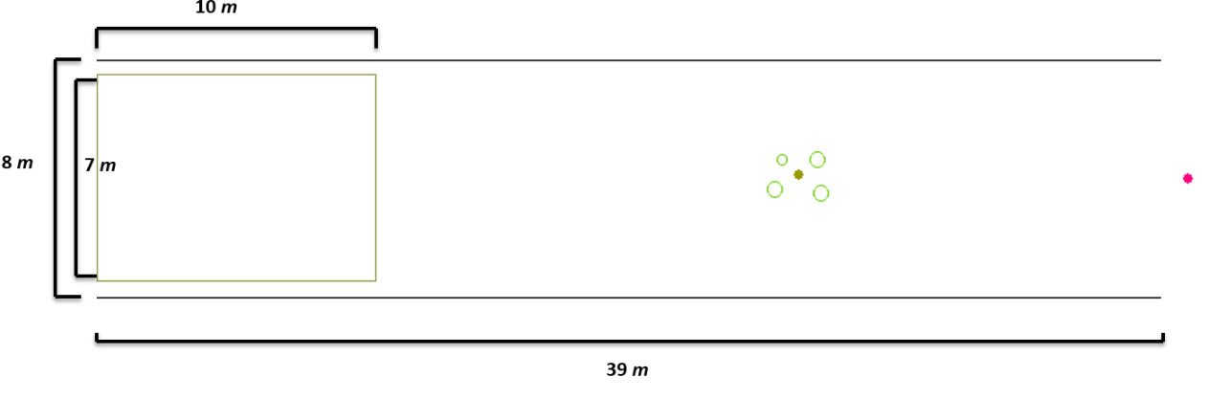
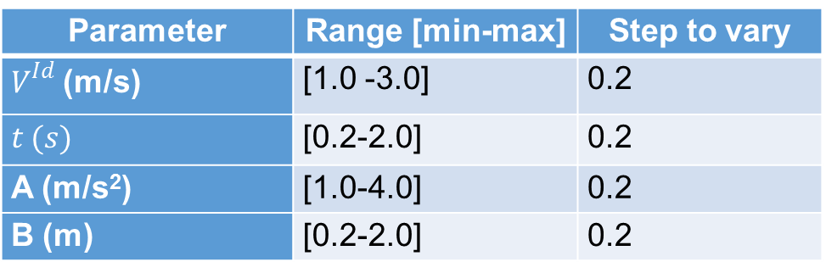
Current work. Q1
Parameter | Range [min-max] | Step to vary
$V^{Id}$ (m/s) | [1.0 -3.0] | 0.2
$$t (s)$$ | [0.2-2.0] | 0.2
A (m/s²) | [1.0-4.0] | 0.2
B (m) | [0.2-2.0] | 0.2
17600 parameter combinations run on Monash Cluster
Notes:
CA-based approach relies on the idea of Von Nonument ,

Slide 17
Current work. Q1. Cohesion Degree
The first two PCs illustrate 65% the variance of four parameters
Notes:
Output parameters are filter at different bins, parameters at that values are selected.
Four dimensional are extracted on principal components
Show the proportion of variance of each parameter explained by firs two PC1s

Slide 18
Current work. Q1. Cohesion Degree
Variance of group cohesion involves the variance of
Interaction Range, Interaction Strength, Velocity

Slide 19
Current work. Q1. Group Average Speed
The first two PCs illustrate 68% the variance of four parameters
Notes:
CA-based approach relies on the idea of Von Nonument ,

Slide 20
Current work. Q1. Group Average Speed
Variance of group cohesion involves the variance of
Interaction Strength, Velocity
Notes:
CA-based approach relies on the idea of Von Nonument ,

Slide 21
Current work. Q1. Group Average Direction
The first two PCs illustrate 73% the variance of four parameters
Notes:
CA-based approach relies on the idea of Von Nonument ,

Slide 22
Current work. Q1. Group Average Direction
Variance of group cohesion involves the variance of
Interaction Strength, Interaction Range, Velocity
Notes:
CA-based approach relies on the idea of Von Nonument ,

Slide 23
Current work. Q1. Analysis and Future Work
Analysis:
PCA only deals with linear interaction
First two PCs couldn’t fully illustrate the variance of input parameters
Future work:
Variance-based analysis
Morris scanning and Sobol methods
Vary parameters at different steps to verify the impact
Notes:
Linear interaction by decomposing original data into the sums of principals components,
First two PCs

Slide 24
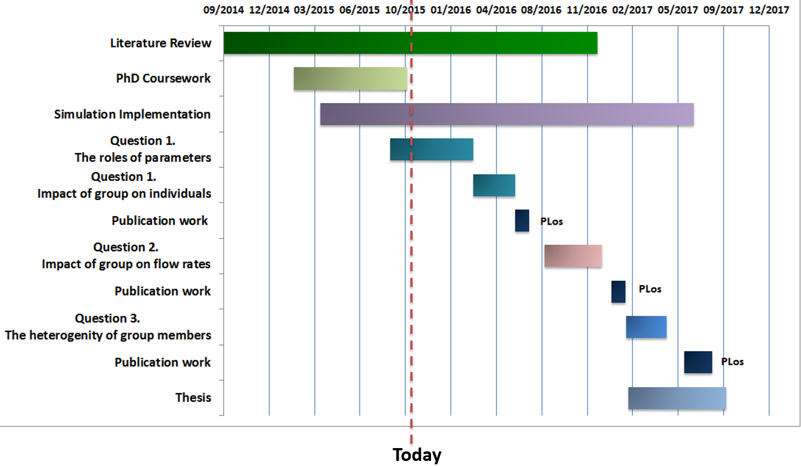
Research Timeline
Notes:
CA-based approach relies on the idea of Von Nonument ,

Slide 25


Course work
Faculty Induction
RST 0005- Research Integrity
FIT 5143- IT Research Methods
FIT 6021- Advanced Research Methods
116/121 research training hours
Notes:
CA-based approach relies on the idea of Von Nonument ,

Slide 26
Current work. Q2
Notes:
CA-based approach relies on the idea of Von Nonument ,

Slide 27
Current work. Q2
Notes:
CA-based approach relies on the idea of Von Nonument ,

Slide 28
THANK YOU
Notes:
CA-based approach relies on the idea of Von Nonument ,

Slide 29
Reference
Notes:
CA-based approach relies on the idea of Von Nonument ,

